Slide 1
KazMove (Moving Service)
For Academic purpose
Kuanysh Amandos,
Arshat Talap, SE-2001

Slide 2
Agenda
Introduction
Project steps
Problems we faced
Outcomes
Conclusion

Slide 3

Introduction
Idea of project is to create a website for moving company

Slide 4
Project steps
Database
Website Layouts
Research
ERD

Slide 5

Step 1: Researching materials

Slide 6
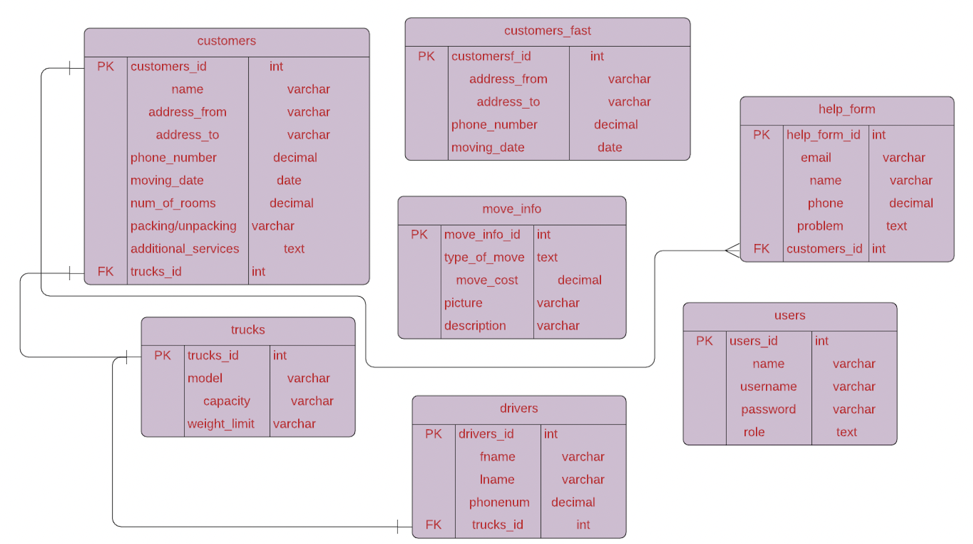
Step 2: ERD

Slide 7
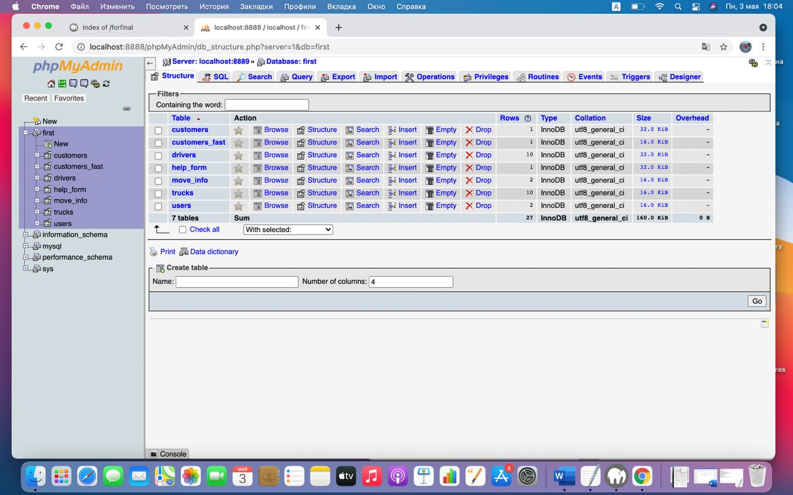
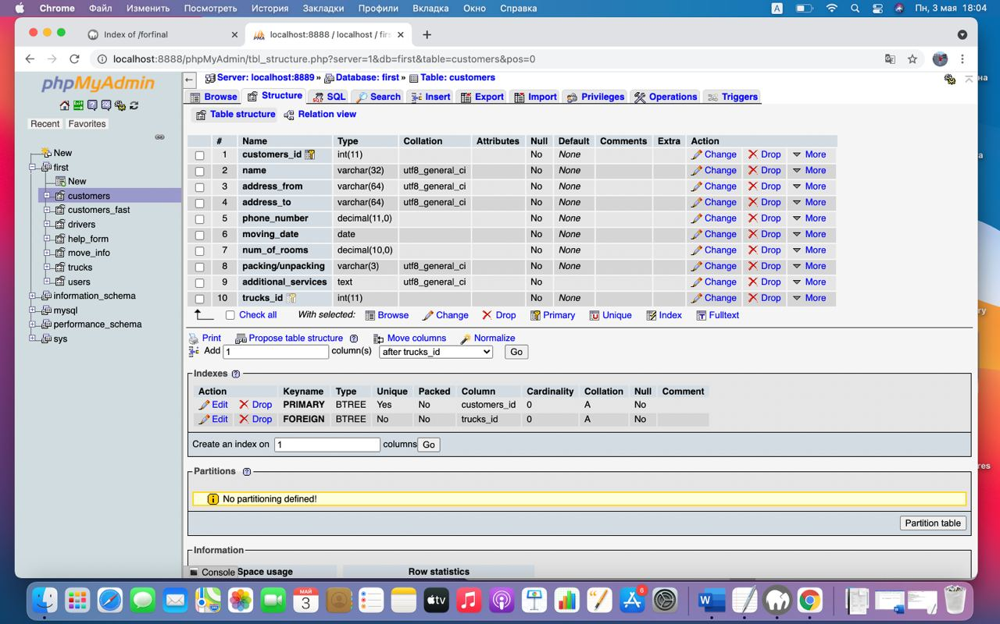
Step 3: Data Base

Slide 8
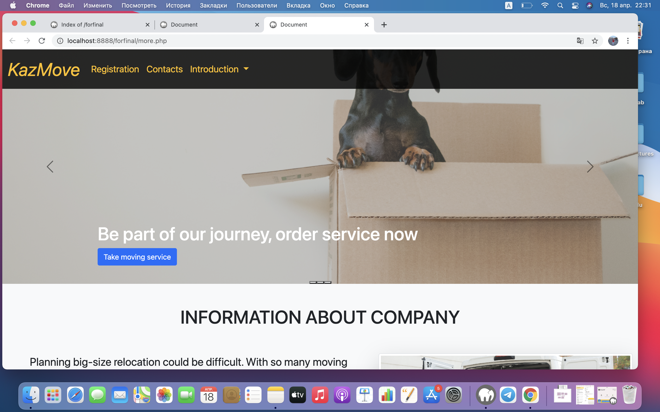
Step 4: Website Layouts

Slide 9

Responsibilities
Arshat
Kuanysh
Make logo & ERD, creating database, php (back-end), JS (functionality)
Website draft (sitemap), fron-end (HTML, CSS), DB Development, adding static files

Slide 10
Problems we faced
Connect tables
Posting registration data into DB
Adding static-files
It was very difficult to figure out which tables to connect
There was problem in carousel with photos
Login, passwords etc. didn’t appear in DB

Slide 11
Learning Outcomes
It is clearly seen, that in our website each entity, each attribute has own purpose and it’s all correspond to the requirements

Slide 12

Conclusion
People had particular struggles with moving process from old house to the new one, as transportation, packing/unpacking goods, choosing right relocation company itself. Considering these moments, this website was created

Slide 13

Thank you for the attention

